Slide 1
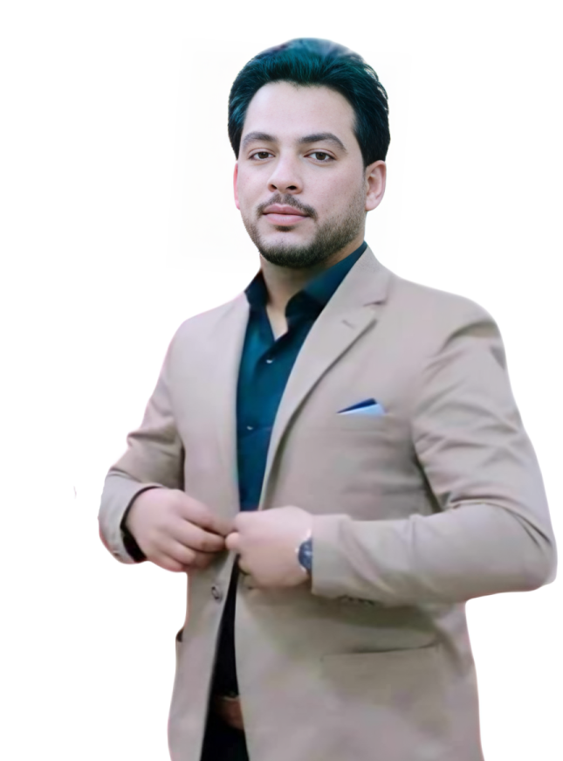



AHMED KAMAL
CIVIL ENGINEER
CONTACT
ABOUT ME
“I seek to apply my skills in design, planning and supervision to engineering projects. I aim to achieve professional development by implementing innovative and sustainable projects that meet customer needs and contribute to improving infrastructure and society. I want to work within a cooperative team that enhances my capabilities and helps me gain new experiences and develop my professional path.”
+20 106 900 7087
Tanta City - Egypt
Ce.ahmedkamal@gmail.com
EXPERIENCES
PERSONAL DATA
Implementation and finishing work for Tanta General Hospital as an executive director at Salah Ismail General Contracting Company from April 2023 until now.
Executive engineer in the construction and reconstruction of Nour City with Talaat Mostafa Group from December 2022 to March 2023
Integrated restoration and efficiency work in Madinaty and restoration of a factory in Badr City from October 2021 to November 2022.
The administrative capital in the Celia Compound, Talaat Mostafa Group, I work with Horus General Contracting Company as an executive director in concrete and finishing works.
Water and irrigation networks work at Darak General Contracting Company in New Mansoura City from January 2020 to October 2021
Concrete, restoration and finishing works at Al Amriya Petroleum Company from December 2018 to January 2020
Restoration work at the Faculty of Engineering and Faculty of Commerce at Mansoura University by New Mix Trading and Contracting Company from July 2017 to October 2017
I trained at New Damietta University in 2016
I trained at the Qalin Water Station in Kafr El-Sheikh Governorate in 2015
Date of birth: April 10, 1993
Marital status: Married
Military service: completed
Egyptian nationality
EDUCATION
Bachelor’s degree in Civil Engineering, graduation year 2017, Delta University of Science and Technology
PERSONAL SKILLS
Ability to work under pressure.
Ability to communicate clearly and tactfully.
Ability to deal friendly.
Ability to manage time better.
Courtesy and professional ethics.
Adaptability.
The ability to search for solutions to problems.
Deal flexibly.
Punctuality.
Self development.
Good appearance and behavior.
EXECUTIVE TASKS
Estimating costs, preparing budgets, and controlling expenses to ensure that the costs allocated to the project are not exceeded.
Plan and supervise the implementation of projects from start to finish, ensuring that they are completed according to the specified schedule and budget.
Study and analyze sites to determine their suitability for construction projects, taking into account factors such as soil, water and the environment.
Prepare detailed reports on project progress, including costs, schedule, and quality of work.
Monitor work on construction sites to ensure compliance with engineering, quality and safety specifications and standards.
COURSES
Implementation and qualification course for a civil engineer
English course from the British International Institute
AutoCAD course
SAP course
ETAPS course
ICDL course
LANGUAGES
Arabic: mother tongue
English: good

